Slide 1

RUNGTA COLLEGE OF DENTAL SCIENCES & RESEARCH
Fibrosseous lesions of jaws &
Osteodystrophies
Dr. Fatima Khan
ORAL MEDICINE, DIAGNOSIS & RADIOLOGY

Slide 2
Objectives
To educate the students about various aspects of Fibro-osseous lesions
To clarify the disparities in classication, clinical & radiological picture of various Fibro osseous lesions .

Slide 3
Specific learning Object
CORE AREAS | DOMAIN | CATEGORY
INTRODUCTION | AFFECTIVE | DESIRE TO KNOW
CLASSIFICATION | COGNITIVE | MUST KNOW
FIBROUS DYSPLASIA | COGNITIVE | MUST KNOW
PAGETS DISEASE | COGNITIVE | MUST KNOW
PERIAPICAL CEMENTO OSSEOUS DYSPLASIA | COGNITIVE | NICE TO KNOW
FLORID CEMENTO OSSEOUS DYSPLASIA | COGNITIVE | NICE TO KNOW
OSSIFYING FIBROMA | AFFECTIVE | NICE TO KNOW
CHERUBISM | AFFECTIVE | NICE TO KNOW
RENAL OSTEODYSTROPHY | PYSCOMOTAR | DESIRE TO KNOW

Slide 4
CONTENTS
INTRODUCTION
CLASSIFICATION
DESCRIPTION OF INDIVIDUAL LESION WITH RADIOLOGICAL PICTURES
FIBROUS DYSPLASIA
PAGETS DISEASE
PERIAPICAL CEMENTO OSSEOUS DYSPLASIA
FLORID CEMENTO OSSEOUS DYSPLASIA
OSSIFYING FIBROMA
CHERUBISM
RENAL OSTEODYSTROPHY
CONCLUSION
REFERENCES

Slide 5
INTRODUCTION:
Benign fibro-osseous lesions of the jaws are described as the replacement of normal bone by tissue composed of collagen fibers and fibroblasts and containing varying amounts of a mineralized substance that may be bony or cementum-like in appearance.
The term Fibro-Osseous Lesions (FOL) has been used for many years as a general description for a group of tumors and proliferative disorders, which affects the jaws.

Slide 6
Classification
ACCORDING TO NEVILLE¹⁵, 2002
Fibrous dysplasia
Cemento-osseous dysplasia
Focal cemento-osseous dysplasia
Periapical cemento-osseous dysplasia
Florid cemento-osseous dysplasia
Ossifying fibroma

Slide 7
ACCORDING TO ANIL GOVIND RAO GHOM¹⁶ 2010
A: Fibro-osseous lesions of medullary bone origin.
Fibrous Dysplasia
Fibro-osteoma
Cherubism
Juvenile ossifying fibroma
Gaint cell tumor
Aneurysmal bone cyst
Jaw lesions in hyperparathyroidism
Paget’s disease

Slide 8
B:Fibro-osseous lesions of periodontal origin.
Periapical cemental dysplasia
Florid osseous dysplasia
Cemento-ossifying fibroma
Cementifying fibroma
Ossifying fibroma

Slide 9
C: Reactive(dysplastic) lesions arising in the tooth bearing area-these are predominently periodontal ligament origin.
Periapical cemento-osseous dysplasia
Focal cement-osseous dysplasia
Florid cement-osseous dysplasia
D:Fibro-Osseous Neoplasm
Cementifying fibroma
Ossifying fibroma
Cemento-ossifying fibroma
Juvenile ossifying fibroma
E: Cherubism.

Slide 10
FIBROUS DYSPLASIA
INTRODUCTION :
Fibrous dysplasia was first described by Lichtenstein in 1938^{1,2} as a disorder characterized by progressive replacement of normal bone elements by fibrous tissue. It is a bone tumor that, although benign, has the potential to cause significant cosmetic and functional disturbance, particularly in the craniofacial skeleton.

Slide 11
CLASSIFICATION
Monostotic fibrous dysplasia- Only one bone is involved
Polystotic fibrous dysplasia- More than one bone is involved
Jaffe type- Fibrous dysplasia involving variable number of bone, accompanied by pigmented lesions of the skin or “café au lait”spots.
Albright’s syndrome- A severe form of fibrous dysplasia involving nearly all the bones in the body, accompanied by pigmented lesions of the skin plus endocrine disturbances of various types.

Slide 12
ORAL MANIFESTATIONS
Monostotic
Sites: Maxilla is more commonly affected than mandible, with most changes occurring in the posterior region. Most commonly premolar-molar area.
Appearance: There may be unilateral facial swelling,which is slow growing with intact overlying mucosa.
Symptoms: Swelling is usually painless but patients may feel discomfort in some cases and while others complain of frank pain.
Cortical plates: Enlarged deformities of alveolar process mainly buccal and labial cortical plates & protuberant excrescence of inferior border of mandible.

Slide 13
Teeth:
The teeth present in the affected area are either mal-aligned and tipped or displaced.
Dental anomalies such as supernumerary teeth have been reported in connection with the monostotic fibrous dysplasia.
The most commonly affected site is maxillary midline and mandibular premolar region.
These supernumerary teeth often remain impacted and may affect the eruption of normal teeth.
Craniofacial fibrous dysplasia
Sites: If fibrous dysplasia extends to involve the maxillary sinus, the zygomatic process, floor of the orbit and sometimes toward the base of the skull, it refers to Craniofacial fibrous dysplasia.

Slide 14
Symptoms: It results in severe malocclusion and marked facial deformity. Craniofacial lesions may lead to anosmia ( loss of sense of smell), deafness and blindness.
Signs: There may be proptosis of the affected eye.
Polyostotic ( Jaffe’s type & Albright syndrome)
Expansion and deformities of the jaws.
The eruption pattern of the teeth is disturbed because of loss of support of the developing teeth.
Asymmetry of the facial bones with ballooning of the jaws, so there is gross enlargement and deformity.
In some cases, intraoral pigmentation can be seen.

Slide 15
Radiographic features of the jaws
Lesions showing predominance of fibrous tissue:
Early – Radiolucent with ill defined borders. The bony defect may be often unilocular but occasionally bony septa may be apparent creating an multilocular cavity.
Margins – Margins may be well defined with a tendency to blend imperceptibly with surrounding normal bone.
Granular appearance- Surrounding the margins of the radiolucent area,there may be wider band of increased density,but granular in appearance.

Slide 16
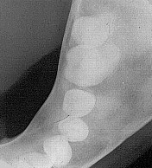
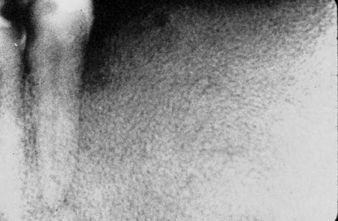

Slide 17
Lamina dura- When the lesion involves the apices of the teeth there is loss of lamina dura or if retained, it has less density than normal.
Teeth – Resorption of roots and destruction of developing teeth.
Jaws – When the lesion comes to the surface, there may be expansion of the jaws.

Slide 18
Mature radiopaque lesions where bone is predominant:
Orange peel
Thumb print appearance
Expansion: Usually extends to the buccal and distal aspects.
Ground glass appearance

Slide 19
Differential Diagnosis
Central gaint cell granuloma
Pagets disease
Osteosarcom

Slide 20
TREATMENT:
Observation and Patient Education
Many lesions are discovered incidentally on radiographs and are asymptomatic. If the radiographic findings are characteristic of fibrous dysplasia, a biopsy is not indicated. Such lesions ordinarily pose no risk for pathologic fracture or deformity, and only clinical observation is warranted.
Follow-up radiographs should be made every six months to verify that there has been no progression. In newly identified cases, a bone scan is needed to exclude a diagnosis of polyostotic disease. When polyostotic disease is found, a referral to an endocrinologist for endocrine and metabolic testing is paramount so that associated endocrine abnormalities can be diagnosed and treated early

Slide 21
PAGET’S DISEASE
Paget’s disease of bone was first described by Sir James Paget under the term ‘‘osteitis deformans’’ in 1877 was refers to as ‘collage of matrix madness’^{50,16,26,49} It is a chronic progressive monostotic or polyostotic disorder characterized by rapid bone resorption and deposition resulting in a ‘‘mosaic’’ pattern of lamellar bone with extensive local vascularity and fibrous tissue in marrow

Slide 22
CLINICAL FEATURES
Paget's disease is a localized disorder of the skeleton with a wide range of skeletal involvement.
Deformity
A common feature of Paget's disease is skeletal deformity.
Paget's disease is quite unusual in the facial bones. Facial disfigurement may be a consequence of enlargement of the maxilla and/or mandible and can be accompanied by spreading of the teeth, malocclusion, and loss of teeth
Due to grotesque facial appearance along with waddling gait and short stature patient has got Simian appearance (like an ape or monkey)

Slide 23
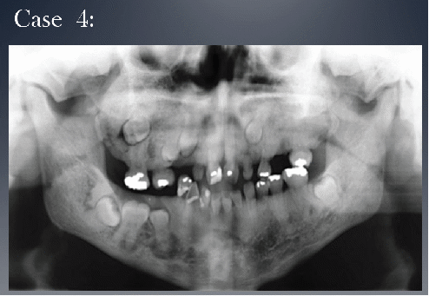
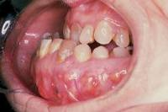

Slide 24
Pain
Pain is a quite common symptom in the population of Paget's disease patients. It may be of skeletal, joint, neurologic or muscle origin.
RADIOGRAPHIC FEATURES: Paget's disease occurs most often in the pelvis, femur, skull, and vertebrae and infrequently in the jaws . It affects the maxilla about twice as often as the mandible. Whenever the jaws are involved, it is important to note whether all of the mandible or maxilla is affected. Although this disease is bilateral, occasionally only one maxilla is involved or the involvement may be significantly greater on one side

Slide 25
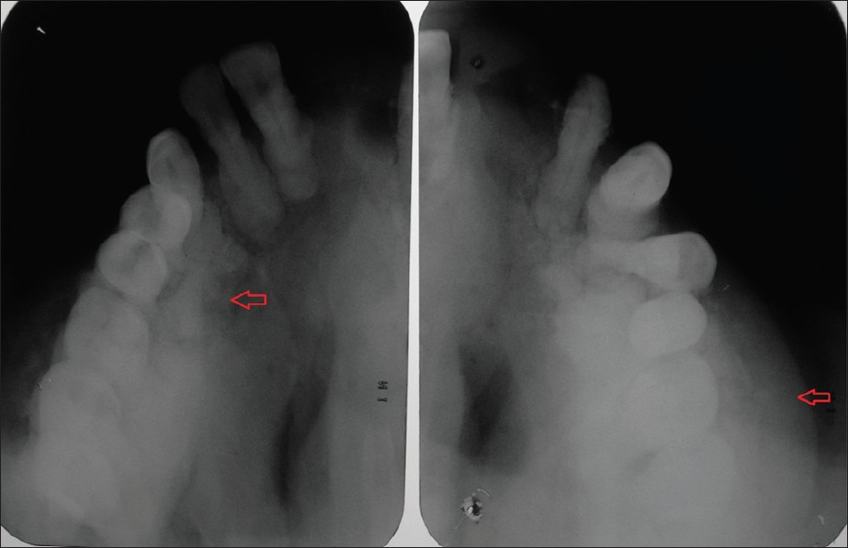

Slide 26
Differential diagnosis
chronic diffuse sclerosing osteomyelitis.
Osteosarcoma
Fibrous dysplasia
Treatment
Calcitonin
Bisphosphonates

Slide 27
THANK YOU

